Slide 1
Barbara Liskov
By Priyanshu Barnwal

Slide 2
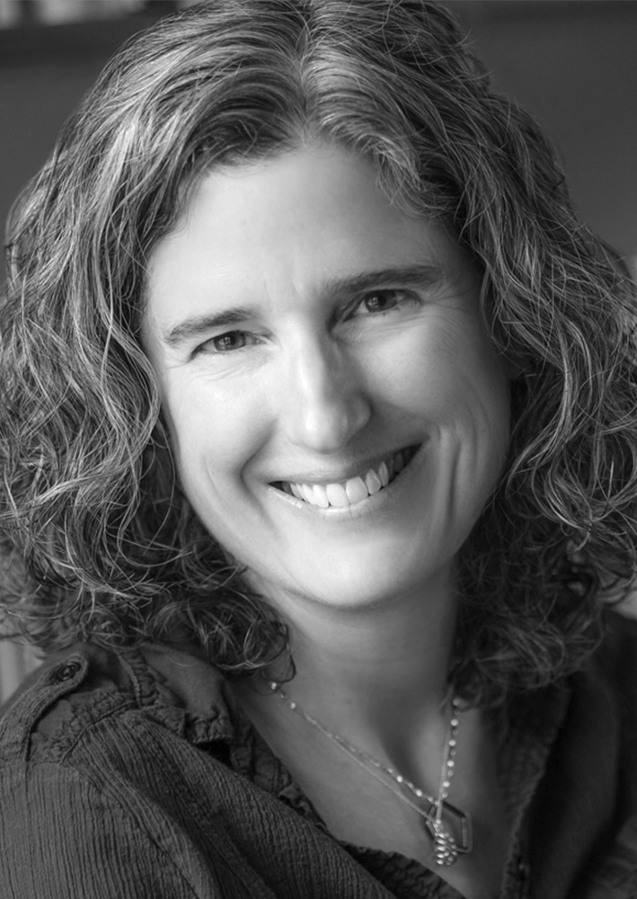
Early Life
Born November 7, 1939 in Los Angeles, California
She graduated from UC Berkley with a Bachelors in mathematics and a minor in physics
One of the first women in the United States to be awarded a PhD from a computer science department, which was from Stanford University.

Slide 3
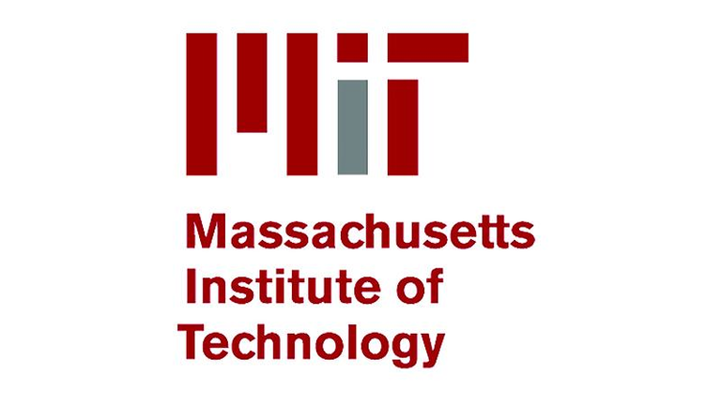
Career
Mitre Corp. out of college
Developed object-oriented programming at her job at MIT
Created Argus and invented data abstraction at MIT
Has more recently worked in the area of distributed systems
Leads the Programming Methodology Group at MIT

Slide 4
Projects
Venus Operating System
ARGUS
Practical Byzantine fault tolerance

Slide 5
Recent Times
Currently the Ford Professor of Engineering at MIT
Appointed Associate Provost for Faculty Equity

Slide 6

Thank you for listening! Questions?

